Slide 1



ЕFFECTIVE ANTIBLEEDING АGENT

Slide 2
Problem
Commercially available anti-bleeding agents are not effective or safe enough
War conflicts
Catastrophes
Surgery
Hemofilia
Blood loss
Deaths
Invalidisation

Slide 3



Brave idea of the project
The best anti-bleeding agent ever!
Fast, effective and safe termination of bleeding
with the use of
Specific activator of blood coagulation
In accordance to the
Sustainable Development Goals of UNO

Slide 4
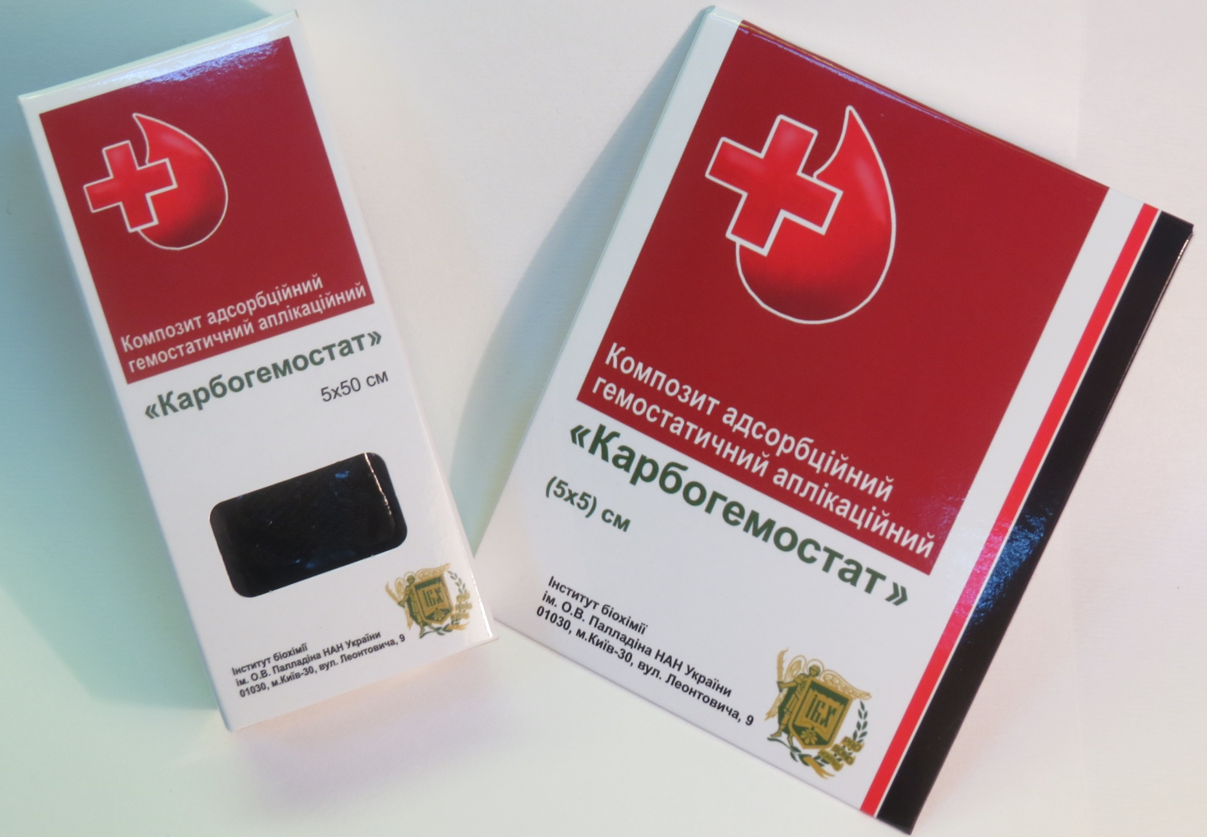
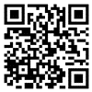
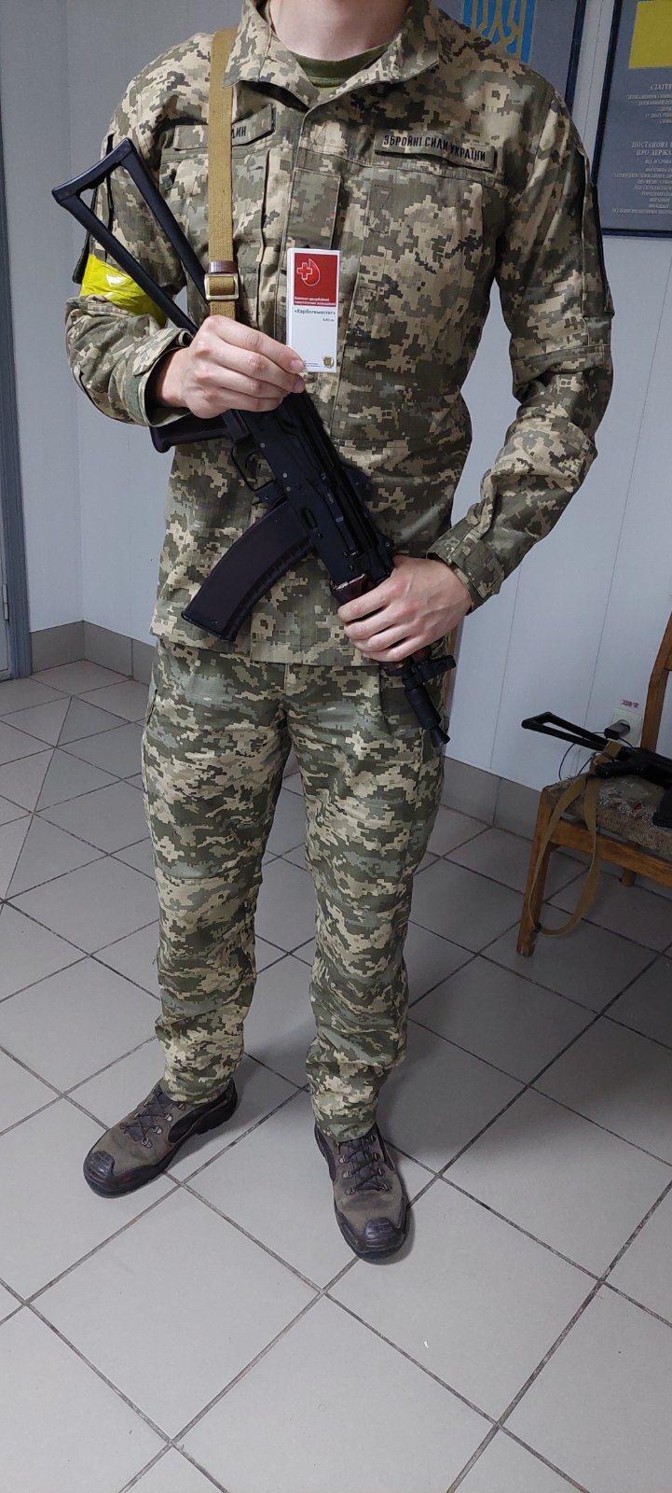
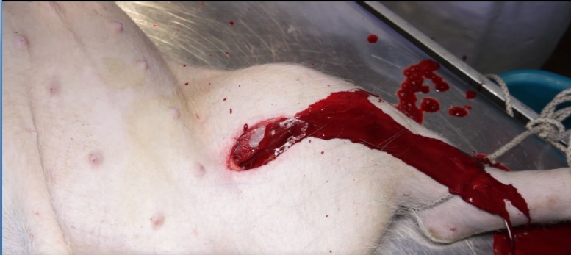
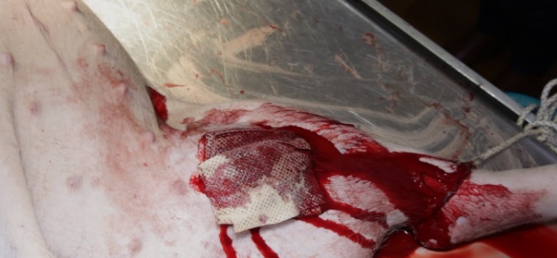
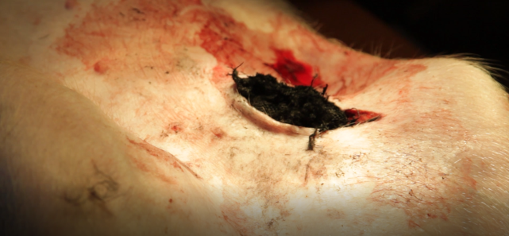
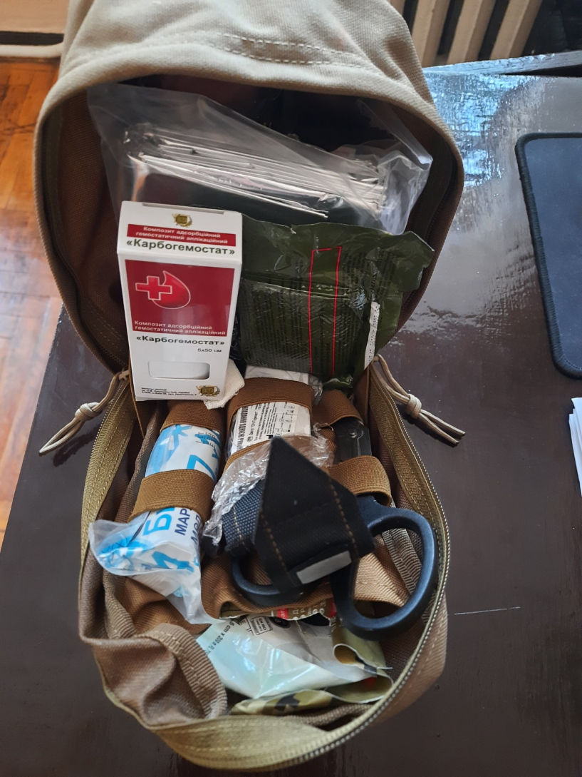
Solution
SPECIFIC ACTIVATOR OF BLOOD CLOTTING
CARBOHEMOSTATE
FIBRIN GEL
Clinical trials performed;
Stops bleeding even from femoral artery;
Approbated on the battlefield
Video of bleeding termination 18+
Induction of massive bleeding from femoral artery of pig
Blood termination by commercially available agent
Blood termination by Carbohemostste

Slide 5
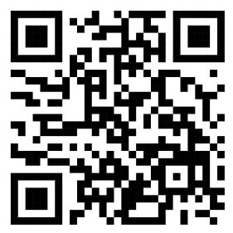
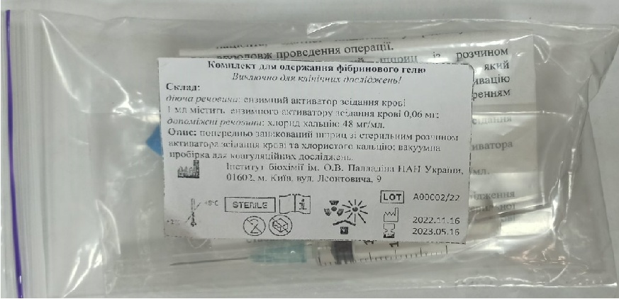
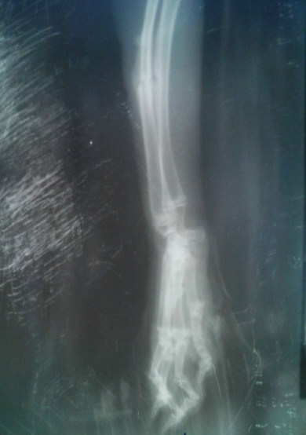
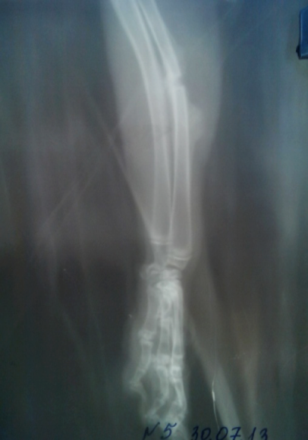
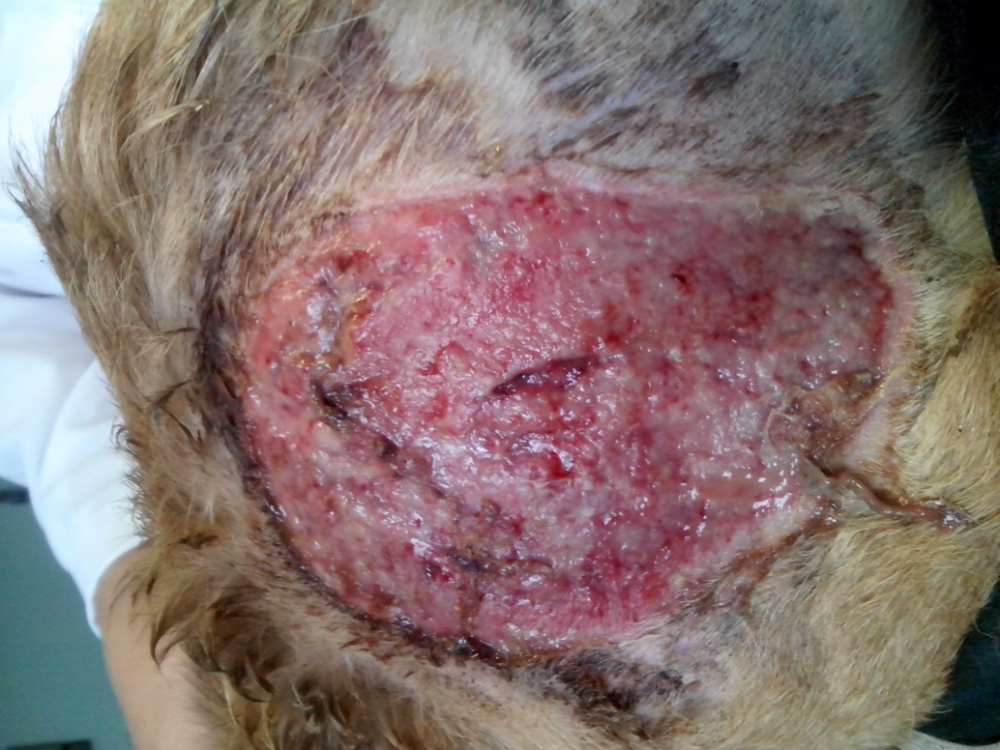
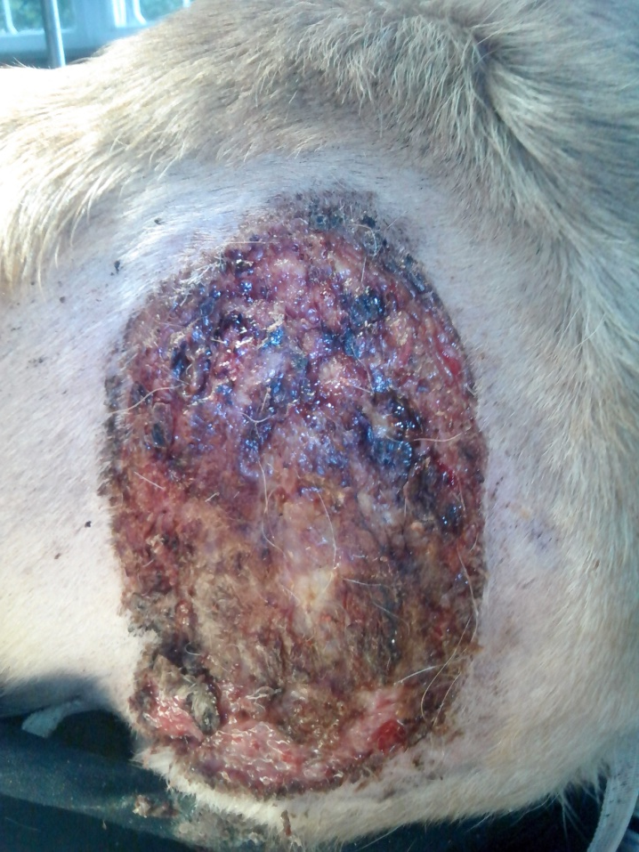
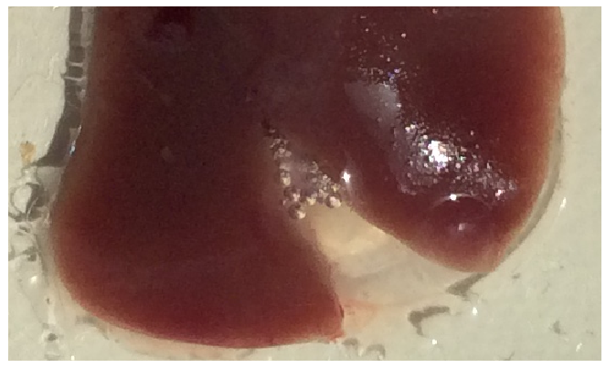
Solution
SPECIFIC ACTIVATOR OF BLOOD CLOTTING
Carbohemostate
Video of obtaining fibrin gel
FIBRIN GEL
Clinical trials performed;
Stimulated regeneration;
Anti-bleeding;
Burns
Germetization of wound
Device for preparation of gel
Bones fracture
Experimental
group
Control
groupа
Experimental
group
Control group

Slide 6
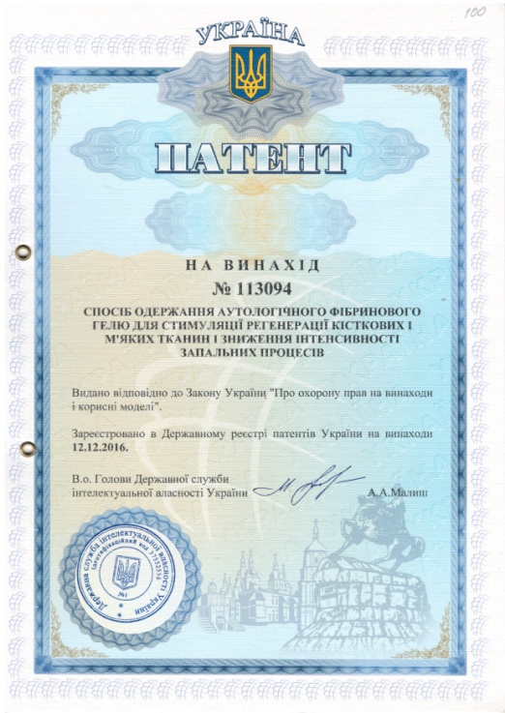
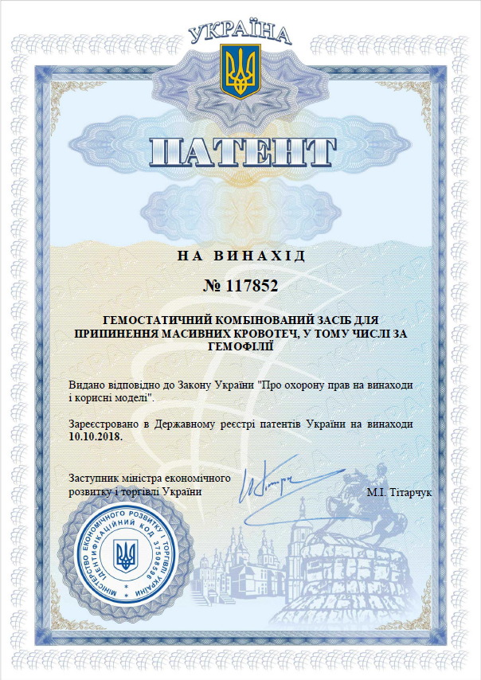
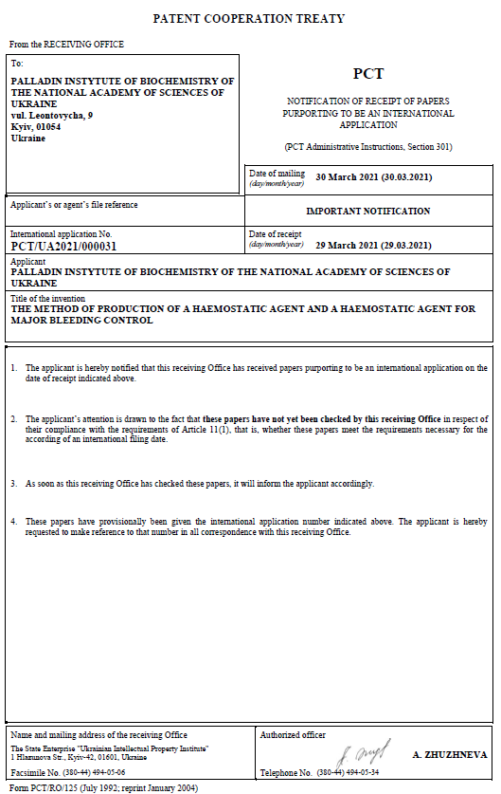
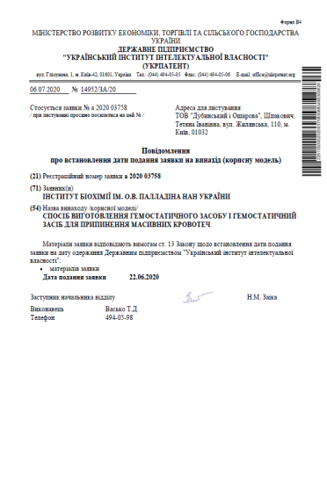
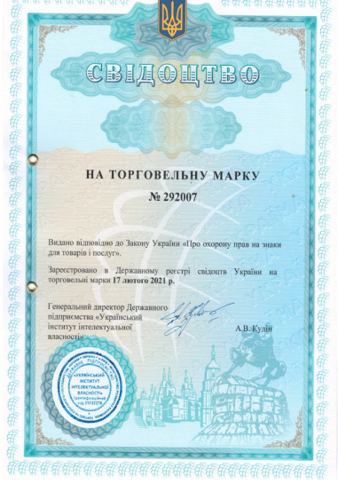
Intellectual property protection
Intellectual property on application of blood clotting activator separately or in a complex with biomaterials belong to the
Palladin Institute of biochemistry of NAS of Ukraine

Slide 7




Competitors analysis
Parameters | Blood coagulation activator in a complex with biomaterials | Hemostatic sponge Biopharma | Tachocomb, Takeda | Celox, MedTrade Procts Electra House | QuikClot, Z-Medica | REVUL БИНТ, Yuria-Pharm
Blood termination | +++ | + | + | ++ | ++ | ++
No antibodies to blood plasma proteins | +++ | - | - | +++ | +++ | +++
No allergic reaction | +++ | - | - | ++ | +++ | ++
No virus infection | +++ | - | - | +++ | +++ | +++
Efficacy at hemophilia | +++ | + | + | + | - | +
Wound healing | +++ | + | +++ | - | - | -

Slide 8
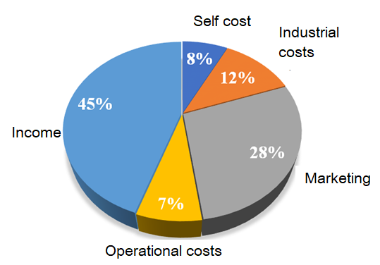
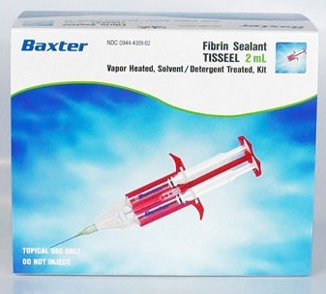
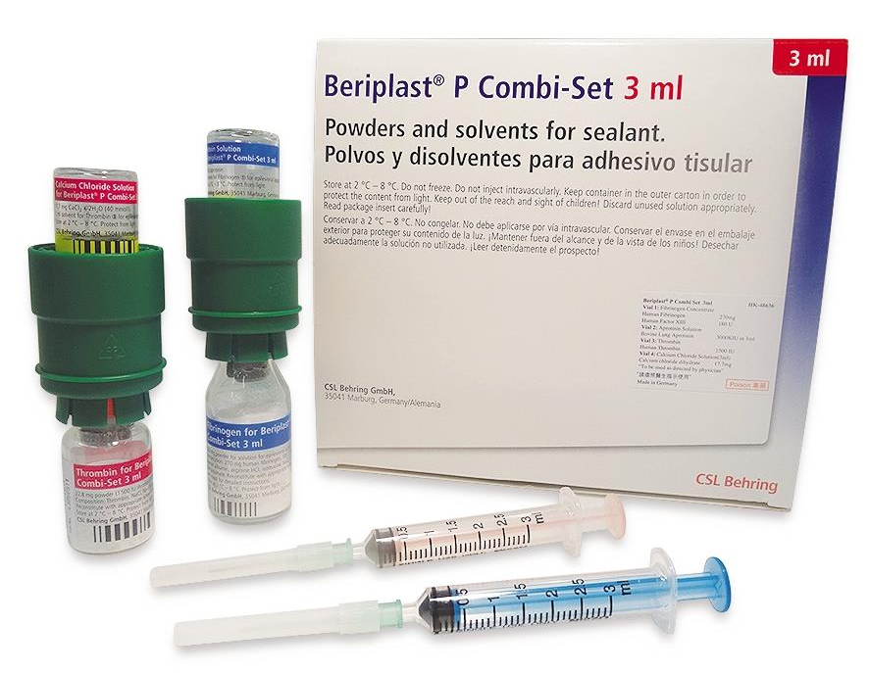
Advantages of fibrin gels
Safer
From 0.1 g of raw stuff we can obtain 2000 sets for the preparation of fibrin gel
No allergic reactions
No infection
Cheaper
1 set for preparation of 1 ml fibrin gel costs 15 USD – 600 UAH
Other fibrin gels cost 80 USD and more for 1 ml.

Slide 9
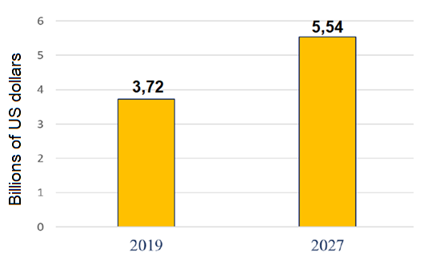
Analysis of world market of anti-bleeding agents
ТАМ SEGMENT
CAGR = 6.3% during prognostic period [2020-2027]
According to the data of Fortune Business Insights

Slide 10
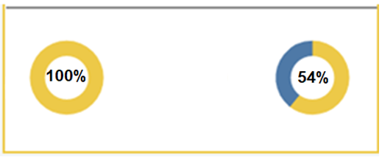
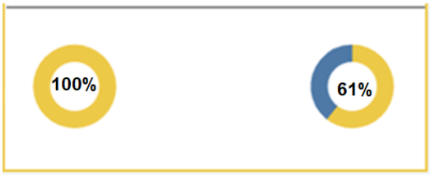
Analysis of Ukraine's demand for of anti-bleeding agents
SAM SEGMENT
According to the data of Ministry of Health of Ukraine in a segment ‘Adult and children hemophilia’
Ratio of supplied and ordered amount of goods
Дитяча гемофілія
Adult hemophilia
2020 рік
Cost of agreements
12 767 384 USD
2022 рік
Cost of agreements
5 140 815 USD
2020
Cost of agreements
19 881 230 USD
2022
Cost of agreements
10 753 948 USD

Slide 11
Customers
The most realistic as a first step
Biggest and most desired
For the prospective development
В2B
В2G
В2C
Ministry of Defence;
Ministry of health;
Medical facilities;
Emergency;
Field medecine
Drivers
(bandages as a component of emergency kits);
customers
Distributors
Private clinics

Slide 12
Optimization of the production of activator
Development and production of blood clotting activator in plant expression system
Synthesis in plants
Lowering of the price of a product while efficacy and safety remained the same.
Enlargement of the panel of products.

Slide 13
The enlargement of a product panel
Application of biomaterials modified by blood clotting activator
Fast regeneration using biodegradable matrix
Effective termination of bleeding
Avoidingof hematomas
Anti-inflammatory and aseptic effect
Germetization of wounds and sutures
Matrix for stem cells

Slide 14
Needs of the Project
Advertisement and promotion of a products
Industrial production of goods
Marketing
studies
Development of recombinant activator
2023-2024 yy. 135 000 USD

Slide 15

Steps to the dreams that come true
7. Enlargement of product assortment
2025
6. Implementation of devices based on the specific blood clotting activator
2024
5. Successful advertisement
2024
4. Clinical and pre-clinical studies with recombinant activator of blood clotting
2024
3. Investitions involvement
2023
2. Recombinant activator development
2023
2023
1. Business-plan

Slide 16
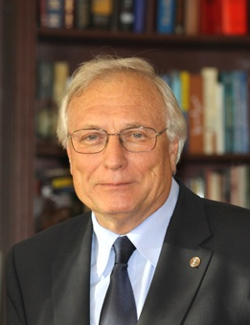
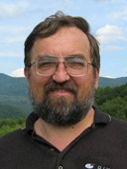
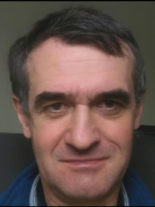
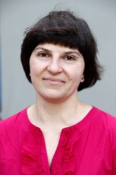
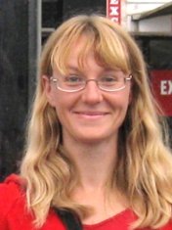
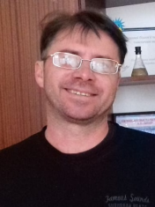
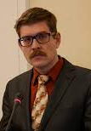
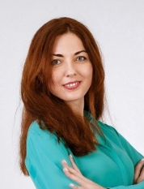
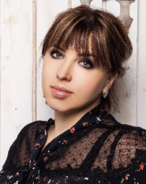
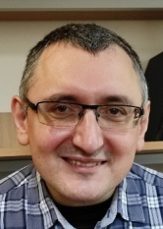
Team
Academician of the National Academy of Sciences and the Academy of Medical Sciences of Ukraine
DrSc, professor,
М. Kuchuk
Creation of a recombinant activator
Development of hemostatic agents
Creating a prototype
PhD
О. Korchynskii
PhD,
D. Korolova
PhD,
Y. Syndarovska
PhD,
Y. Symonenko
DrSc,
V. Chernyshenko
International financial expert and project management,
O. Pykuza
Highly qualified expert in business development, introduction of new products to the market, business scaling
L. Yaroshenko
Business & Marketing
PhD,
V. Gryshchuk

Slide 17
THANK YOU!
Contact persons:
Volodymyr Chernyshenko
bio.cherv@gmail.com
+38 067 590 67 10 (Viber, Telegram, WhatsApp)
Volodymyr Gryshchuk
gryshchukv@gmail.com
+38 050 152 37 39 (Viber, Telegram, WhatsApp)

Slide 19
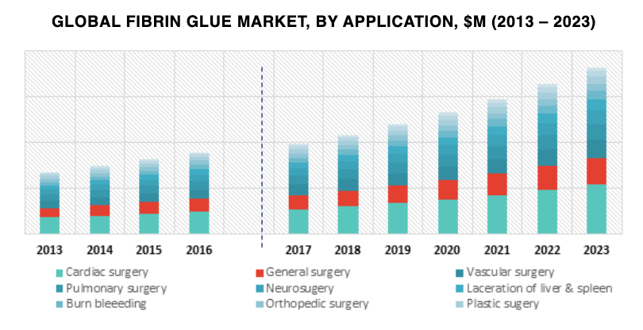
Market of fibrin-based «glues»
ТАМ segment
SAM segment
Not available in Ukraine
Source:
https://www.psmarketresearch.com/market-analysis/fibrin-glue-market

